Slide 1
Task democracy workshop
Task democracy is a model for political polycrisis decision making,
designed to accelerate sustainability transitions
Facilitator edition 241014, for preparing your workshop. Copy this to your presentation edition and remove all slides with orange background or orange title, and remove all orange facilitator suggestions.
Peter Bootsma^{1,}*
¹ Noorden Duurzaam association, The Netherlands
* peter.bootsma@noordenduurzaam.nl
1
Copyright (c): Vereniging Noorden Duurzaam 2024.
Reuse license: Creative Commons BY-SA 4.0 International (https://creativecommons.org/licenses/by-sa/4.0/)
Notes:
1

Slide 2
Timing – Two hour pressure cooker, or take more time and add a break
Introduction 13.30 + 15 min
Objectives 13.30 + 2 min
What are we going to do? 13.32 + 1 min
Eisenhower matrix quiz 13.33 + 10 min
Task groups model 13.43 + 2 min
Set a transition agenda (role play) 13.45 + 45 min
Introduction: round table model 13.45 + 10 min
Task groups: choose an issue and prepare a pitch 13.55 + 5 min
Pitches: what issue should be addressed first? 14.00 + 5 min
Deliberation: clarify, support, criticise 14.05 + 10 min
Voting: sorting the issues. Consent? 14.15 + 5 min
Conclusions 14.20 + 10 min
Design a society wide transition project (role play) 14.30 + 45 min
Introduction: topic, Hauser, canvas, values 14.30 + 10 min
Task groups: brainstorm organisations and contributions 14.40 + 10 min
Pitches: organisations, contributions 14.50 + 5 min
Spotting synergy between contributions 14.55 + 8 min
Next steps in real applications 15.03 + 2 min
Conclusions 15.05 + 10 min
Conclusions, takeaway, follow up 15.15 + 15 min
Voting outcomes 15.15 + 2 min
Expected method benefits 15.17 + 5 min
Costs and pitfalls 15.22 + 5 min
Political decision making during crises [RESOLVED?] 15.27 + 1 min
Action perspectives for transitions on your agenda 15.28 + 1 min
Support/community, thank you 15.29 + 1 min

Slide 3
Workshop objectives - your takeaway
Understanding task-democratic transition management
Action perspectives for your industry, sector, community or territory
Option: join the task democracy research and practice community

Slide 4
What are we going to do?
How to solve the polycrisis (quiz)
Set a transition agenda (role play)
Design a society wide transition project (role play)
Conclusions, takeaway, follow up
>>> The link to download this powerpoint is on the last slide <<<

Slide 5
How to solve the polycrisis – Facilitator suggestions
Preparation: get some background on the Eisenhower matrix, e.g. https://www.eisenhower.me/eisenhower-matrix/. We use an inverted matrix, to position the least desirable crises (acute and existential) in the bottom right corner. Left unattended, top-left crises may eventually amplify each other into bottom-right.
Explain the matrix axes: horizontal is impact, vertical is timing, or time to respond.
Show crises types and corresponding modes of political decision making, clockwise from top-left. The top right corner, where the polycrisis unfolds, has no decision making mode but a big question mark.
Quiz: discuss with your neighbour what type of political decision making is needed at the question mark? One of the other three corners? We take n [3 to 5] minutes.
OK, lets vote on this. What type of decision making do we need to solve the polycrisis in the top right corner?
Optionally ask questions to stimulate critical thinking. No discussion at this point, just vote so we see our initial thinking. This slide will return at the end of the workshop.
Who votes for liberal democracy as in top left?
Optional question: Will it unite us, when we cannot afford to be devided?
Who votes for government crisis response as in bottom left?
Optional question: Will it mobilise all of society, when government action alone is not enough?
Who votes for war time decision making as in bottom right?
Optional question: Do we accept emergency legislation while there is time for democracy?
Anyone for repressive autocratic leadership?
Optional question: Will it serve society and step down when crisis is over?
Conclusion (probably): undecided! None of our current political tools can out of the box solve the slow but existential polycrisis. So let’s find out a new option.

Slide 6
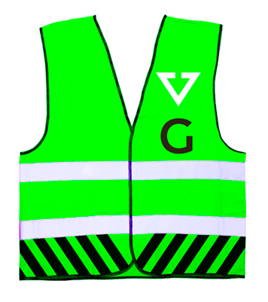

How to solve the polycrisis
Impact
Crisis type | Manageable: it won’t kill us | Existential: it will eventually wipe us out!
Slow: there is time
Acute: act now!
Labor migration, asylum migration
Natural resource shortages
Nitrogen crisis
Grid congestion
Housing crisis
Poverty
Drug crime
Extreme inequality, polarisation
Agriculture soil degradation
Geopolitical tensions
Climate migration
Biodiversity crisis (6th mass extinction, pollinator decline, ocean acidification)
Climate crisis (extreme weather, sea level rise, desertification)
?
Liberal democratic decision making: Parliaments on all levels decide on policies, laws, budgets and public administration
Timing
Water shortages
Local floodings
Pandemics
Wildfires
Hurricanes
Terrorism
Dike breach
Famine
Foreign aggression
Civil war
Government staff
decision making: Crisis or emergency response teams deploy emergency services, police public health authorities, water boards, etc.
War time decision making: War cabinets deploy the military, mobilise all sectors of society, ask allies for help

Slide 7
Transition task division
Facilitator suggestion: The new option we’ll be exploring is transition task division, between five task groups: science, citizens, government, businesses and non-profits. They are independent: in each one of them transition efforts are initiated. They are also interdependent: none of their tasks can be missed in sustainability transitions. Their independence and interdependence makes them equal partners. Let’s step into a role play to experience this first hand.
Task group | Transition tasks
Science | Measure capitals, explain history, predict, identify development pathways
Citizens | Adjust lifestyle, support each other, raise kids with sustainability values, vote
Government | Set rules, ensure level playing fields, enable, communicate, encourage
Businesses | Invest and innovate for sustainability impact, organise inclusively, close loops
Non-profits | Inspire people, qualify students, build and connect communities, inclusion

Slide 8
The Transition Council – Facilitator suggestions
Preparation, in case you want random distribution to multiple breakouts
Paste a floorplan here with colored breakout rooms, decide number of breakouts to use, stick Post-it notes on all seats, in selected room colors, equal numbers
Or: give participants numbers like 1-2-3-1-2-3-
Suggestion
On your seat is a Post-it note in the color of your breakout room. When you step into this room, you are a member of the Transition Council.
Our facilitators are the independent chair and secretary.
You have been democratically elected by one of five task groups. We ask you to step in this role.
Let’s move and get started!

Slide 9
Task-democratic council
Agenda-setting session

Slide 10
Task-democratic council / Agenda-setting session - Facilitator suggestions
Preparation
Arrange a round, oval, rectangular or square table with a minimum of 12 seats. Not a ‘U’-shape. It should mimic the round table in the next slide. The presentation screen is behind the grey chair position.
Print and fold A4 role cards (there is an Excel name cards file for this in the community drive). Choose name cards or role cards. Choose preset roles per participant, participant chosen roles, or random distribution of roles. Number of seats per task group may be somewhat different, e.g. 2 in Science, 4 in Citizens, 3 in Government, etc. Distribute the role cards as in the next slide (same order, starting clockwise from the chair position with Science.
Print an A4 handout for each task group (see file in community drive).
Choose whether to use the task democracy voting system, or a manual procedure, or other means. The voting system prototype is at https://www.noordenduurzaam.nl/stemsysteem. Ask for an account in time and familiarise yourself with the app.
Each breakout can be chaired by one facilitator. It you are two, take roles as chair and secretary.
Facilitator suggestions
Welcome to this breakout session! We’ll be doing a role play simulation of coordinating a society wide transition.
Briefly introduce participants and yourself as needed
Introduce the breakout objective: to explore how the task democracy method can create coherent and synergetic society wide transition projects
Introduce the round table model and the three step policy cycle (next slide)
Introduce the reason for a round table: in transition projects, the five task groups are independent and interdependent, and thus equals. In the table diagram this is indicated by equally sized positions. Equality is assured by equal speaking time and equal voting power between task groups, regardless of numbers of represented people and numbers of representatives. Another saveguard is the addition of an independent chair.
Remind of the tasks of each task group. The task of the independent chair/secretary is order keeping, time management, transparency.
Introduce the policy cycle. Three steps are needed: 1) deciding what transition issue to take on next, 2) initiating a large project for it, and 3) monitoring transition progress.
Step into your role as chair
Welcome to this meeting! Each of your task groups has 2 [or more] representatives, democratically elected by major task group networks.
So we are a democratic representation of all of society. Not by ideology but by transition task.
Our reason for being is to cause a flow of society wide transition projects for system change, in order to counter the polycrisis.
In this meeting we will see an overview of urgent transition issues and we will decide for which one to initiate a society wide project.

Slide 11
Task-democratic council / Agenda-setting session
Structure
Process
GOVERNMENT
Make sustainability attractive
Arrange level playing field
CITIZENS
Change lifestyle
Support each other
Teach children
BUSINESSES
Innovate products, processes and organisations
Agenda-setting
Transition projects
Monitoring
SCIENCE
Measure
Explain
Predict
Warn
NON PROFITS
Inspire
Qualify
Connect
Resilience
INDEPENDENT CHAIR
Connect, encourage, facilitate
Notes:
De vereniging Noorden Duurzaam stelt voor dat we in een functioneel democratische parlementaire kamer, ongeacht lokaal, provinciaal of nationaal niveau, vijf vakken hebben: bewoners, bedrijven, voorzieningen, kennisnetwerken en overheden.
Bij bewoners gaat het om representatieve netwerken van burgers. Dat kunnen algemene netwerken zijn zoals verenigingen voor dorpsbelangen, of meer specifieke netwerken van bijvoorbeeld senioren, jongeren, huurders, woningeigenaren. Ook consumentennetwerken en vakbonden kunnen hier meegerekend worden. Deze netwerken kunnen elkaar dus overlappen.
Bij bedrijven gaat het om landelijke, regionale en lokale brancheverenigingen van grote ondernemingen, MKB en ZZP, en om lokale parkmanagementverenigingen. Ook ketennetwerken van bedrijven horen hierbij.
Bij voorzieningen gaat hem koepels van onderwijs, zorg, sport, cultuur, levensbeschouwing. Ook deze zijn op zowel nationaal als lokaal niveau te vinden.
Bij kennisnetwerken is het IPCC van de VN een goed voorbeeld. Dit wereldwijde netwerk van klimaatwetenschappers is van groot belang voor duurzaamheidstransities, is uniek, open, representatief en democratisch en heeft door deze combinatie een grote invloed op klimaatbeleid van regeringen. Ook nationale en lokale kennisnetwerken voor biodiversiteit, sociale cohesie, energietransitie of erfgoed kunnen relevant, uniek, open, representatief en democratisch zijn.
Bij overheden gaat het niet alleen om openbaar bestuur maar ook om overheids- en semi-overheidsorganen die rechtstreeks kunnen bijdragen aan duurzaamheidstransities. Bijvoorbeeld toezichthouders, milieudiensten, rechtbanken en de GGD.
De veronderstelling is dat deze vijfdeling stabiel is en praktisch inzetbaar. Dus dat deze vijf er altijd zijn en dat ze altijd nodig zijn bij transities, dat ze afhankelijk zijn van elkaar en elkaar niet willen verdringen. Wat niet wil zeggen dat er geen inzicht- en belangenverschillen bestaan overigens.Maar waar het om gaat is dat een stabiele vijfdeling een praktisch bruikbare basis is voor maatschappijbrede taakverdeling en samenwerking voor duurzaamheidstransities, zoals de driedeling bij de waterschappen praktisch bruikbaar is voor waterbeheer.
Discussievraag: klopt de vijfdeling? Of hadden het vier of zes moeten zijn?

Slide 12
Task-democratic council / Agenda-setting session
Introduction: round table model, policy cycle
Task groups: summarise generic task group interests
Task groups: choose an issue and prepare a pitch
Pitches: what issue should we address first?
Deliberation: clarify, support, criticise
Voting: sort the issues
Conclusions
2. Facilitator suggestion: To get started, do a short brainstorm in your task group about this question: What are general interests of your task group main transition topic and within our territory? Take notes, write clearly and keep them visible in front of you.

Slide 13
Task-democratic council / Agenda-setting session
Introduction: round table model, policy cycle
Task groups: summarise generic task group interests
Task groups: choose an issue and prepare a pitch
Wave and tidal energy develop too slow
Investments in oil and gas exploration are dropping
North Sea solar power potential is underresearched
The electron to molecule transition is lagging behind
Insufficient labour available to the energy industry
International collaboration is insufficient
Geopolitical uncertainty puts a brake on investments
North Sea energy production damages ecosystems
Horizon pollution by wind parks
Government investments are insufficient
… or choose any other relevant issue
Pitches: what issue should we address first?
Deliberation: clarify, support, criticise
Voting: sort the issues
Conclusions
3. Preparation: replace this list with real transition issues within your topic and territory.
3. Facilitator suggestion: Pick one issue from this list or choose any other issue you find is the most urgent within our main transition topic and within our territory. Prepare a 30 second pitch in which you explain 1) what the issue is, 2) what will happen if we do nothing or too little about it, 3) why this absolutely needs to be prevented. So just an issue and why it hurts. Not a solution yet.

Slide 14
Task-democratic council / Agenda-setting session
Introduction: round table model, policy cycle
Task groups: summarise generic task group interests
Task groups: choose an issue and prepare a pitch
Pitches: what issue should we address first?
Each task group gets 30” to pitch their issue
No interruptions
The council secretary enters each issue in the voting system
Deliberation: clarify, support, criticise
Voting: sort the issues.
Conclusions
4. Facilitator suggestion: Switch to the voting system using the link. Open the voting session you prepared. Click Issues. During the pitches, fill in issue titles and a one sentence description or some keywords. Don’t click other buttons yet. if you do you can’t get back. In that case go to Sessions, copy your session and continue from there. Try this beforehand.

Slide 15
Task-democratic council / Agenda-setting session
Introduction: round table model, policy cycle
Task groups: summarise generic task group interests
Task groups: choose an issue and prepare a pitch
Pitches: what issue should we address first?
Deliberation: clarify, support, criticise
The chair gives the task groups equal speaking time. Use this to ask clarification, support or criticise
Other task groups may respond and interrupt
Voting: sort the issues.
Conclusions
5. Facilitator suggestion: Ask taskgroups in turn to emphasise their issue, support others, ask for clarifications, or criticise. Keep time, cut off and turn to the next group to stay on schedule.

Slide 16
Task-democratic council / Agenda-setting session
Introduction: round table model, policy cycle
Task groups: summarise generic task group interests
Task groups: choose an issue and prepare a pitch
Pitches: what issue should we address first?
Deliberation: clarify, support, criticise
Voting: sort the issues in the voting system
Registration
Pick up the QR code with your phone. Don’t move away or restart
Select your role and click Save. When all are registered: click Voting page
Voting
Sort the issues to your task group’s preference
Click Vote
Conclusions
6. Facilitator suggestion: Use the link to open the voting system. Click Register and wait until all are registered. Then click Vote and aks all to click Voting page and sort the issues. If all are done click Result.

Slide 17
Task-democratic council / Agenda-setting session
7a. Facilitator suggestion: Stay in your role. Consent is: ‘no objections’. Emphasise that #2 and up are not lost and may become #1 next time around in the policy cycle. Maybe later this year. Also if your issue didn’t win, supporting #1 may help getting support for your issue next time. This may help those who doubt.
Introduction: round table model, policy cycle
Task groups: summarise generic task group interests
Task groups: choose an issue and prepare a pitch
Pitches: what issue should we address first?
Deliberation: clarify, support, criticise
Voting: sort the issues
Conclusions
Do we consent to initiate #1 as our next joint transition project?
Can this method accelerate decision making in a polycrisis?
7b. Facilitator suggestion: Now step out of your role and reflect with your participants. Compare task democratic to liberal democratic prioritising of transition issues. Would political parties in a parliament arrive at a consent decision sooner? Even if so, how would they motivate the task groups?

Slide 18
Task-democratic council
Transition design session

Slide 19
Task-democratic council / Transition design session - Facilitator suggestions
Preparation
Read up on the Hauser 2014 research in the extra slides in this file. It shows a potentially steep increase in society wide project appreciation and participation when everyone would participate. It would make collective responsibility possible.
Arrange for a separate table large enough for the A0 canvas OR rearrange your tables after the Hauser slide.
Print an A0 brainstorm canvas from the pdf file. The original design is in the Extra slides, at the end. If you translate it, sharing in the task democracy community is appreciated. Cut along the lines so the taskgroups can be taken apart, filled in, and put back together. Use small pieces of detachable masking tape for easier handling (you’re going to draw arrows across cutting lines and without some tape the paper may slide away).
This breakout can be chaired by one facilitator. It you are two, take roles as chair and secretary.
Facilitator suggestions:
Welcome to this breakout session! We’ll be doing a role play simulation of how to coordinate a transition, society wide.
Introduce participants and yourself as needed
Introduce the breakout objective: Explore whether the task democracy method can create coherent and synergetic society wide transition projects
We now are a transition project team initiated by the transition council. We are experts and influentials from five task groups.
The council has set an agenda, an issue priority order. They now ask us to initiate a society wide transition project for issue #1. Our task is coordinate voluntary transition efforts from five task groups. There is no need for power shift or regime change here (contrary to other transition theory). Task groups, including public administration, decide themselves about what to put on the table, through their representatives.
Explain the Hauser 2014 research.
Turn to the brainstorm table (or rearrange and put the canvas on top). Ask all to gather around it.
Explain the working order and the questions.
Fill in topic (1) and territory (2) yourself
Ask for some values that are at stake in this transition. Fill in at (3). Values may be (seemingly) unconvenable, e.g. economic growth and biodiversity.
Task group brainstorm: ask the task groups to take their own segment of the canvas, sit apart and brainstorm about questions 4 and 5.
Pitches: give turns to the task groups to briefly name the organisations and possible contributions.
Synergy spotting: give turns to the task groups to spot one synergy between any two contributions. Reward what they find and draw an arrow. Do multiple rounds until it is evident that there is a lot of synergy if all task groups participate.
Next steps: turn back to the powerpoint. Explain what steps can be taken next if this were a real project. Might someone suggest to do this for real then point out you need a mandate, so set up a council first and do agenda-setting as in the previous session.
Conclusions: summarise, reflect on the direct result, then on the method.

Slide 20
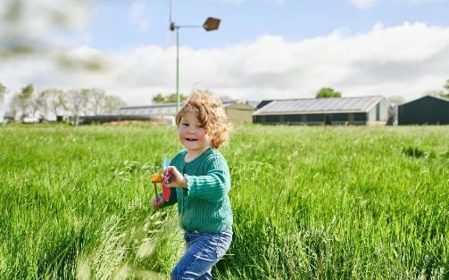
Task-democratic council / Transition design session
“Would you live more sustainable to secure a liveable world for your grandchildren?”
68% YES 32% NO
“Would you live more sustainable to secure a liveable world for your grandchildren, when everyone else does?”
100% YES 0% NO
Facilitator suggestion: 100% is an exceptional finding. Hauser tested the robustness of this result by replacing the grandchildren with grandgrandchildren. Het got 100% again and could stretch up to twelve generations. This finding illustrates collective responsibility is possible. Also: peer pressure and fear of missing out may help to unite us. It means we need to create transition projects in which everyone has a task and can participate actively.
Hauser et al., Cooperating with the future, 2014, cited in Hickel, Less is More, 2021, p245

Slide 21
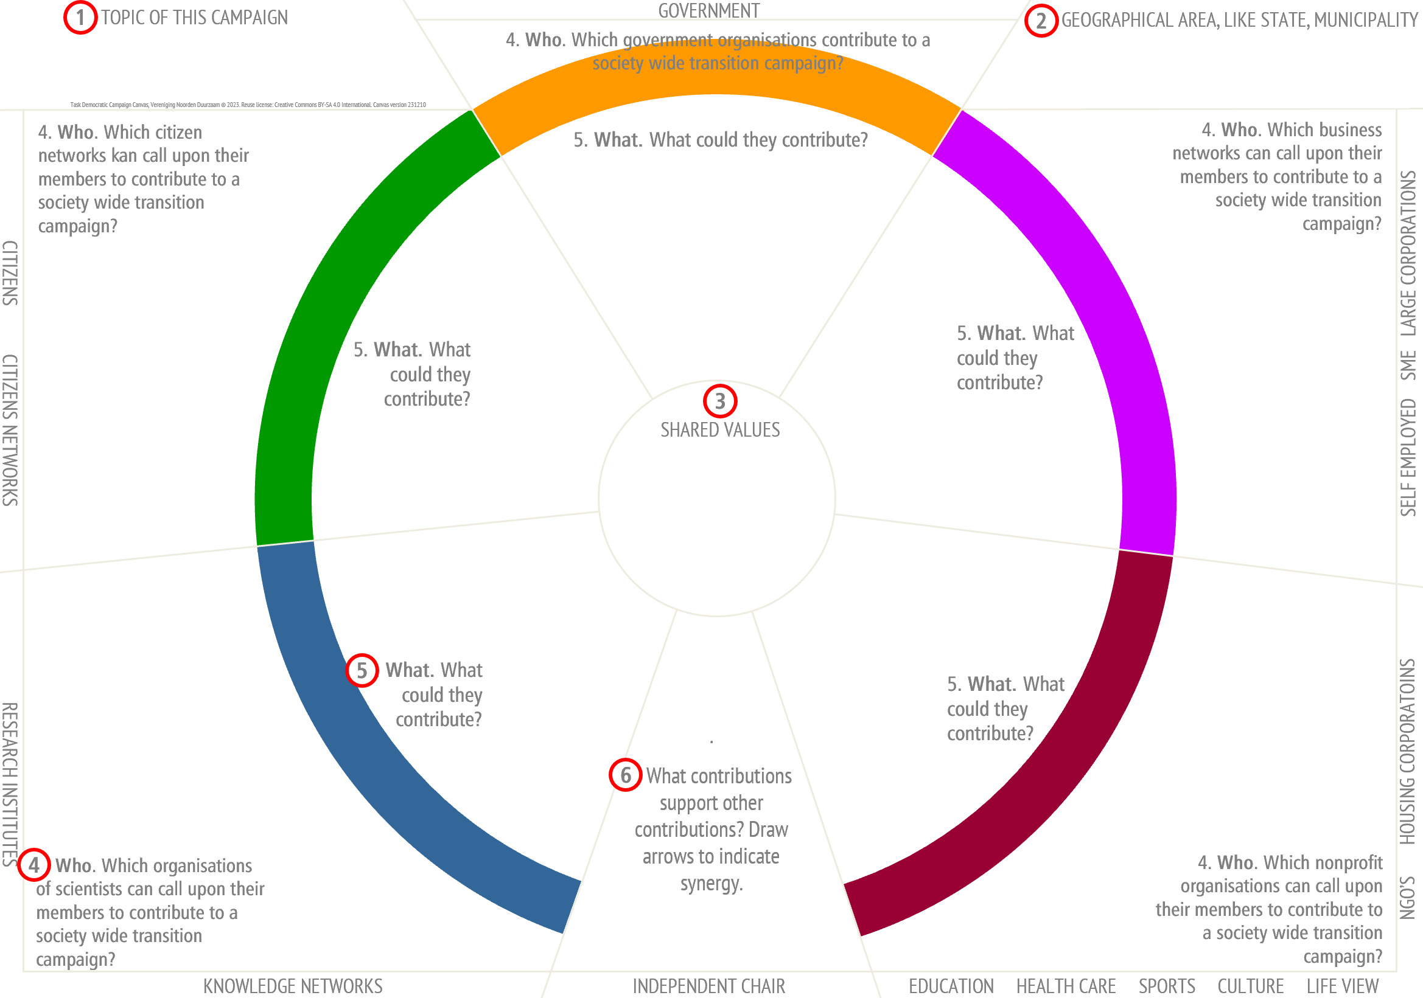
Task-democratic council / Transition design session
Introduction: topic, Hauser, canvas, values
Task groups: brainstorm organisations and contributions
What organisations may contribute?
What contributions might they make?
Pitches: organisations, contributions
Spotting synergy between contributions
Next steps in real applications
Conclusions
4
5

Slide 22
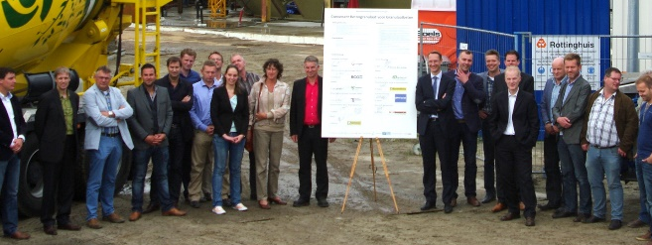
Task-democratic council / Transition design session
Facilitator suggestion: This picture shows the kick off of a transition project to close the loop of concrete in the municipality of Groningen, 2013. All key players of the value chain were here. The agreement consisted of relatively small contributions from all of them, fine-tuned for synergy. It reportedly reduced import of virgin gravel by 20%. Collaboration was slow at start but picked up speed when one entrepreneur commented “I won’t start on my own, but we wouldn’t object being forced together”. In other words: I will, if everyone else does.
Introduction: topic, Hauser, canvas, values
Task groups: brainstorm organisations and contributions
Pitches: organisations, contributions
Spotting synergy between contributions
Next steps in real applications
Negotiate compensation for disadvantaged task groups by all other task groups
Develop the canvas into a draft transition agreement
Ask all organisations on the canvas for conditional intentions
Would they contribute in case everyone else does?
Iterate and revise if needed, until sufficient buy in
Get everyone to sign the agreement in a transition kick off meeting
Monitor impact and adjust as needed
Conclusions
Facilitator suggestion: 1) Handling the polycrisis require radical measure, beyond the compromises liberal democracy can produce. In radical measures it is important to compensate disadvantaged task groups. What is easier: negotiating this compensation between the task groups themselves or between political parties (who may not even agree on the need for measures)?

Slide 23
Task-democratic council / Transition design session
Introduction: topic, Hauser, canvas, values
Task groups: brainstorm organisations and contributions
Pitches: organisations, contributions
Spotting synergy between contributions
Next steps in real applications
Conclusions
We’ve seen: task-democratic transition project design
By five independent and interdependent and thus equal task groups,
who brainstorm to find synergy between transition contributions,
do iterative consulting to fine tune a society wide campaign design,
organise a high profile public kick off,
and monitor progress.
Could it work?
Make negotiating radical measures + society wide cost distribution easier?
Proliferate horizontally and scale up, to any level?
Accelerate sustainability transitions?
Facilitator suggestion: a) to summarise. b) If not: the urgency is still there. Options: e.g. redo the brainstorm, more time, resources, experts, more pressure from the transition concil, other team. c) Are radical measures + compensations enough to achieve (local, regional) impact? d) Challenge: can we think of a territory or value chain where this approach cannot work?

Slide 24
Plenary wrap-up

Slide 25
Wrap up – Definition
Task democracy is
parliamentary round table collaboration by five independent and interdependent, and therefore equal task groups representing all of society,
that coordinate voluntary sustainability transition efforts from all of society,
by prioritising transition issues, by initiating and facilitating transition projects, and by transition monitoring,
in a generic pattern that is compatible with current regimes and may proliferate and scale up from local to global,
for the purpose of mitigating slow but existential crises.

Slide 26
Wrap up – Costs and pitfalls of the task democracy model
Hypothetical and unproven? Yes, so research
Newness anxiety? Yes, so gamify, simulate
Additional government layer? No, it fixes current patchwork
Representation is complex? Yes, so set rules
Interest groups resist? Yes, so name them task groups
MP’s resist? Possibly, so involve in experiments

Slide 27
Wrap up – How to solve the polycrisis [RESOLVED?]
Facilitator suggestion: who would vote to experiment with task democracy?
Impact
Crisis type | Manageable: it won’t kill us | Existential: our civilisation is at stake!
Slow: there is time
Acute: act now!
Labor migration, asylum migration
Natural resource shortages
Nitrogen crisis
Grid congestion
Housing crisis
Poverty
Drug crime
Extreme inequality, polarisation
Agriculture soil degradation
Geopolitical tensions
Climate migration
Biodiversity crisis
Climate crisis
Liberal democratic decision making: parliaments on all levels decide on policies, laws, budgets and public administration
Task-democratic decision making? transition chambers and product councils coordinate voluntary efforts from all sectors of society
Timing
Water shortages
Local floodings
Pandemics
Wildfires
Hurricanes
Terrorism
Dike breach
Famine
Foreign aggression
Civil war
Government staff
decision making: crisis or emergency response teams deploy emergency services, police public health authorities, water boards, etc.
War time decision making: war cabinets deploy the military, mobilise all sectors of society, ask allies for help

Slide 28
Wrap up – Your action perspectives
Read up on task democracy: noordenduurzaam.nl/taskdemocracy
Share this idea.
Join the research and practice community: noordenduurzaam.nl/community
Facilitate a workshop like this, be an ambassador
Activate your network, gather opinion leaders from five task groups
Apply this model collectively in your territory
Establish transition chambers and product councils
Thank you!

Slide 29
Extra’s

Slide 30
Wrap up - Expected benefits of the task democracy model
Enables to unite and mobilise all of society for sustainability transitions
Favours radical change + compensation over compromising
Compatible: extension to liberal democracy, no regime change
Crisis resistant: medieval roots, survived to this day
Scalable: from sublocal to global, generic model
Easy proliferation: open access concept, community

Slide 31
1
GOVERNMENT
2
TOPIC OF THIS CAMPAIGN
4. Who. Which government organisations contribute to a society wide transition campaign?
GEOGRAPHICAL AREA, LIKE STATE, MUNICIPALITY
Task Democratic Campaign Canvas, Vereniging Noorden Duurzaam © 2023. Reuse license: Creative Commons BY-SA 4.0 International. Canvas version 231210
4. Who. Which business networks can call upon their members to contribute to a society wide transition campaign?
4. Who. Which citizen networks kan call upon their members to contribute to a society wide transition campaign?
5. What. What could they contribute?
.
6 What contributions support other contributions? Draw arrows to indicate synergy.
5. What. What could they contribute?
5. What. What could they contribute?
SELF EMPLOYED SME LARGE CORPORATIONS
CITIZENS CITIZENS NETWORKS
3
SHARED VALUES
5. What. What could they contribute?
5
5. What. What could they contribute?
4. Who. Which nonprofit organisations can call upon their members to contribute to a society wide transition campaign?
4. Who. Which organisations of scientists can call upon their members to contribute to a society wide transition campaign?
6
RESEARCH INSTITUTES
NGO’S HOUSING CORPORATOINS
4
KNOWLEDGE NETWORKS
INDEPENDENT CHAIR
EDUCATION HEALTH CARE SPORTS CULTURE LIFE VIEW

Slide 32
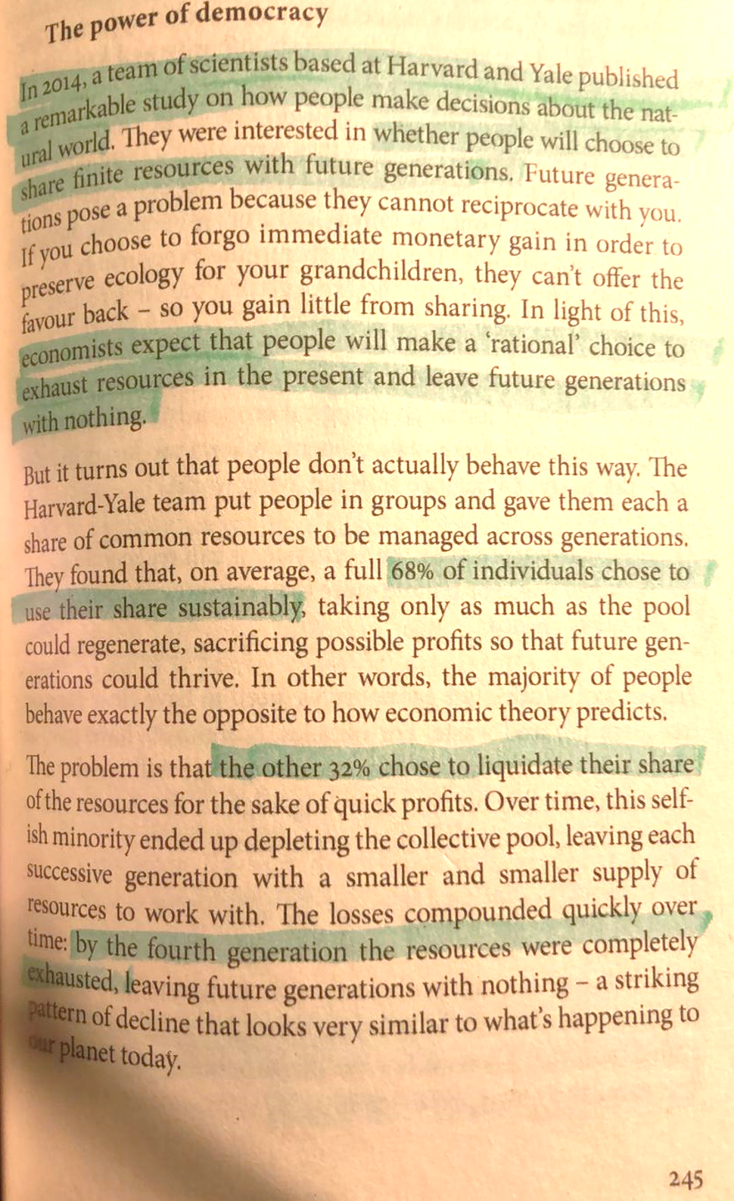
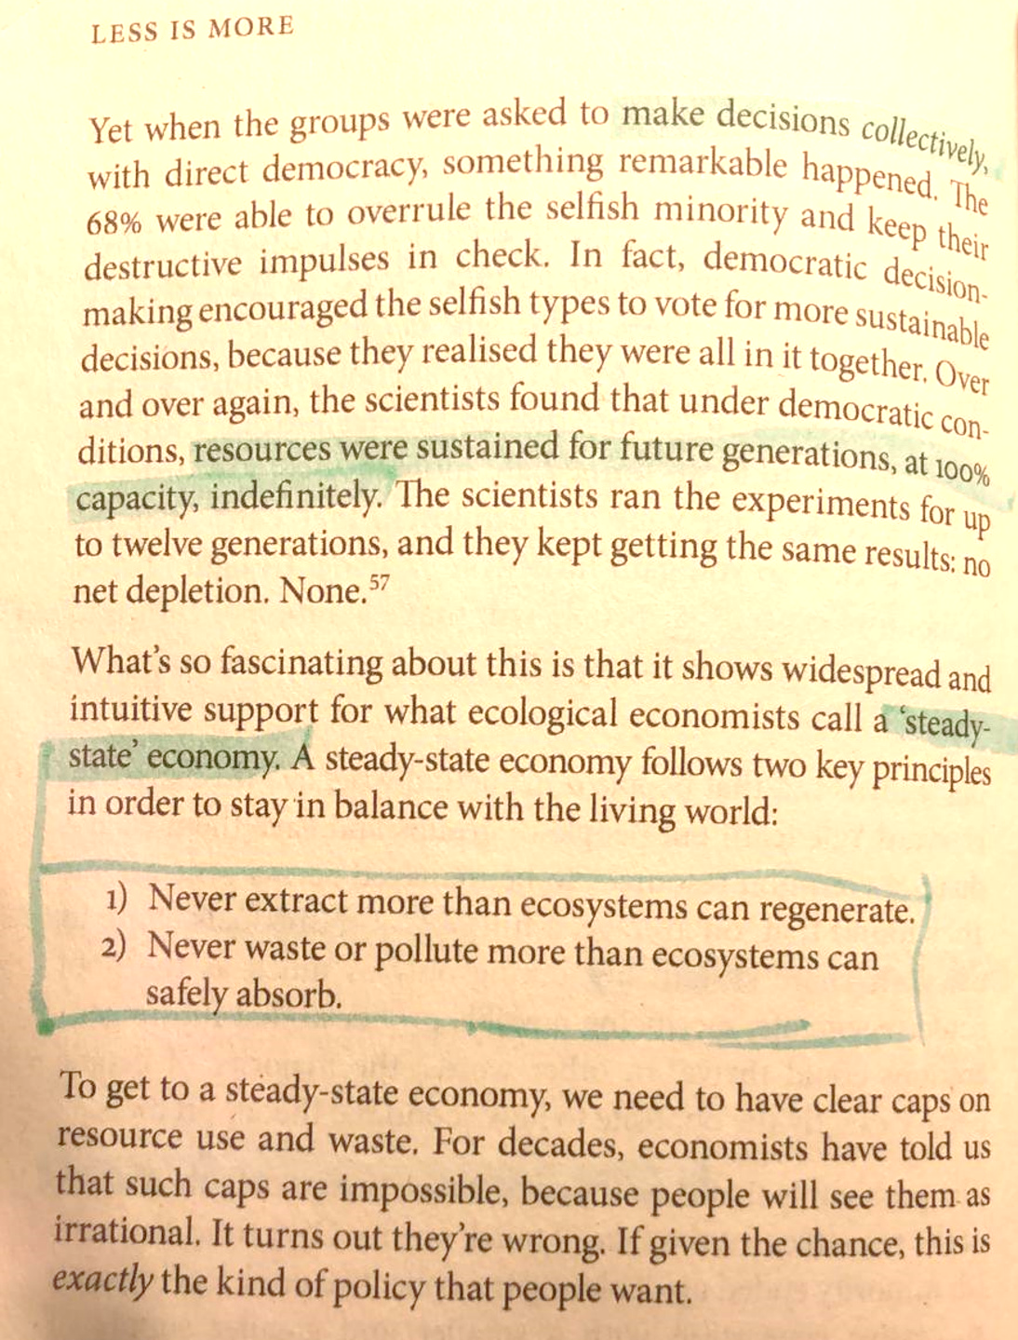
Hauser, 2014
Hauser, O. P., Rand, D. G., Peysakhovich, A., & Nowak, M. A. (2014). Cooperating with the future. Nature, 511(7508), Article 7508. https://doi.org/10.1038/nature13530
Cited in Hickel, J. (2021). Less is More. Penguin Random House. https://www.jasonhickel.org/less-is-more

Slide 33
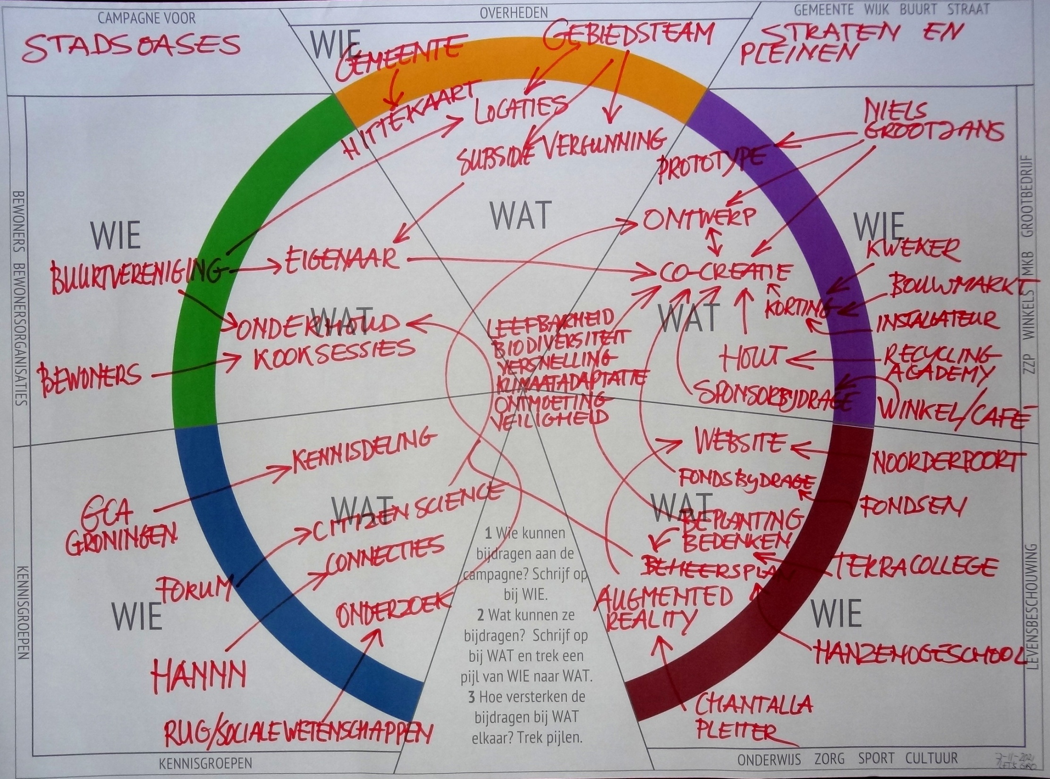

Slide 34
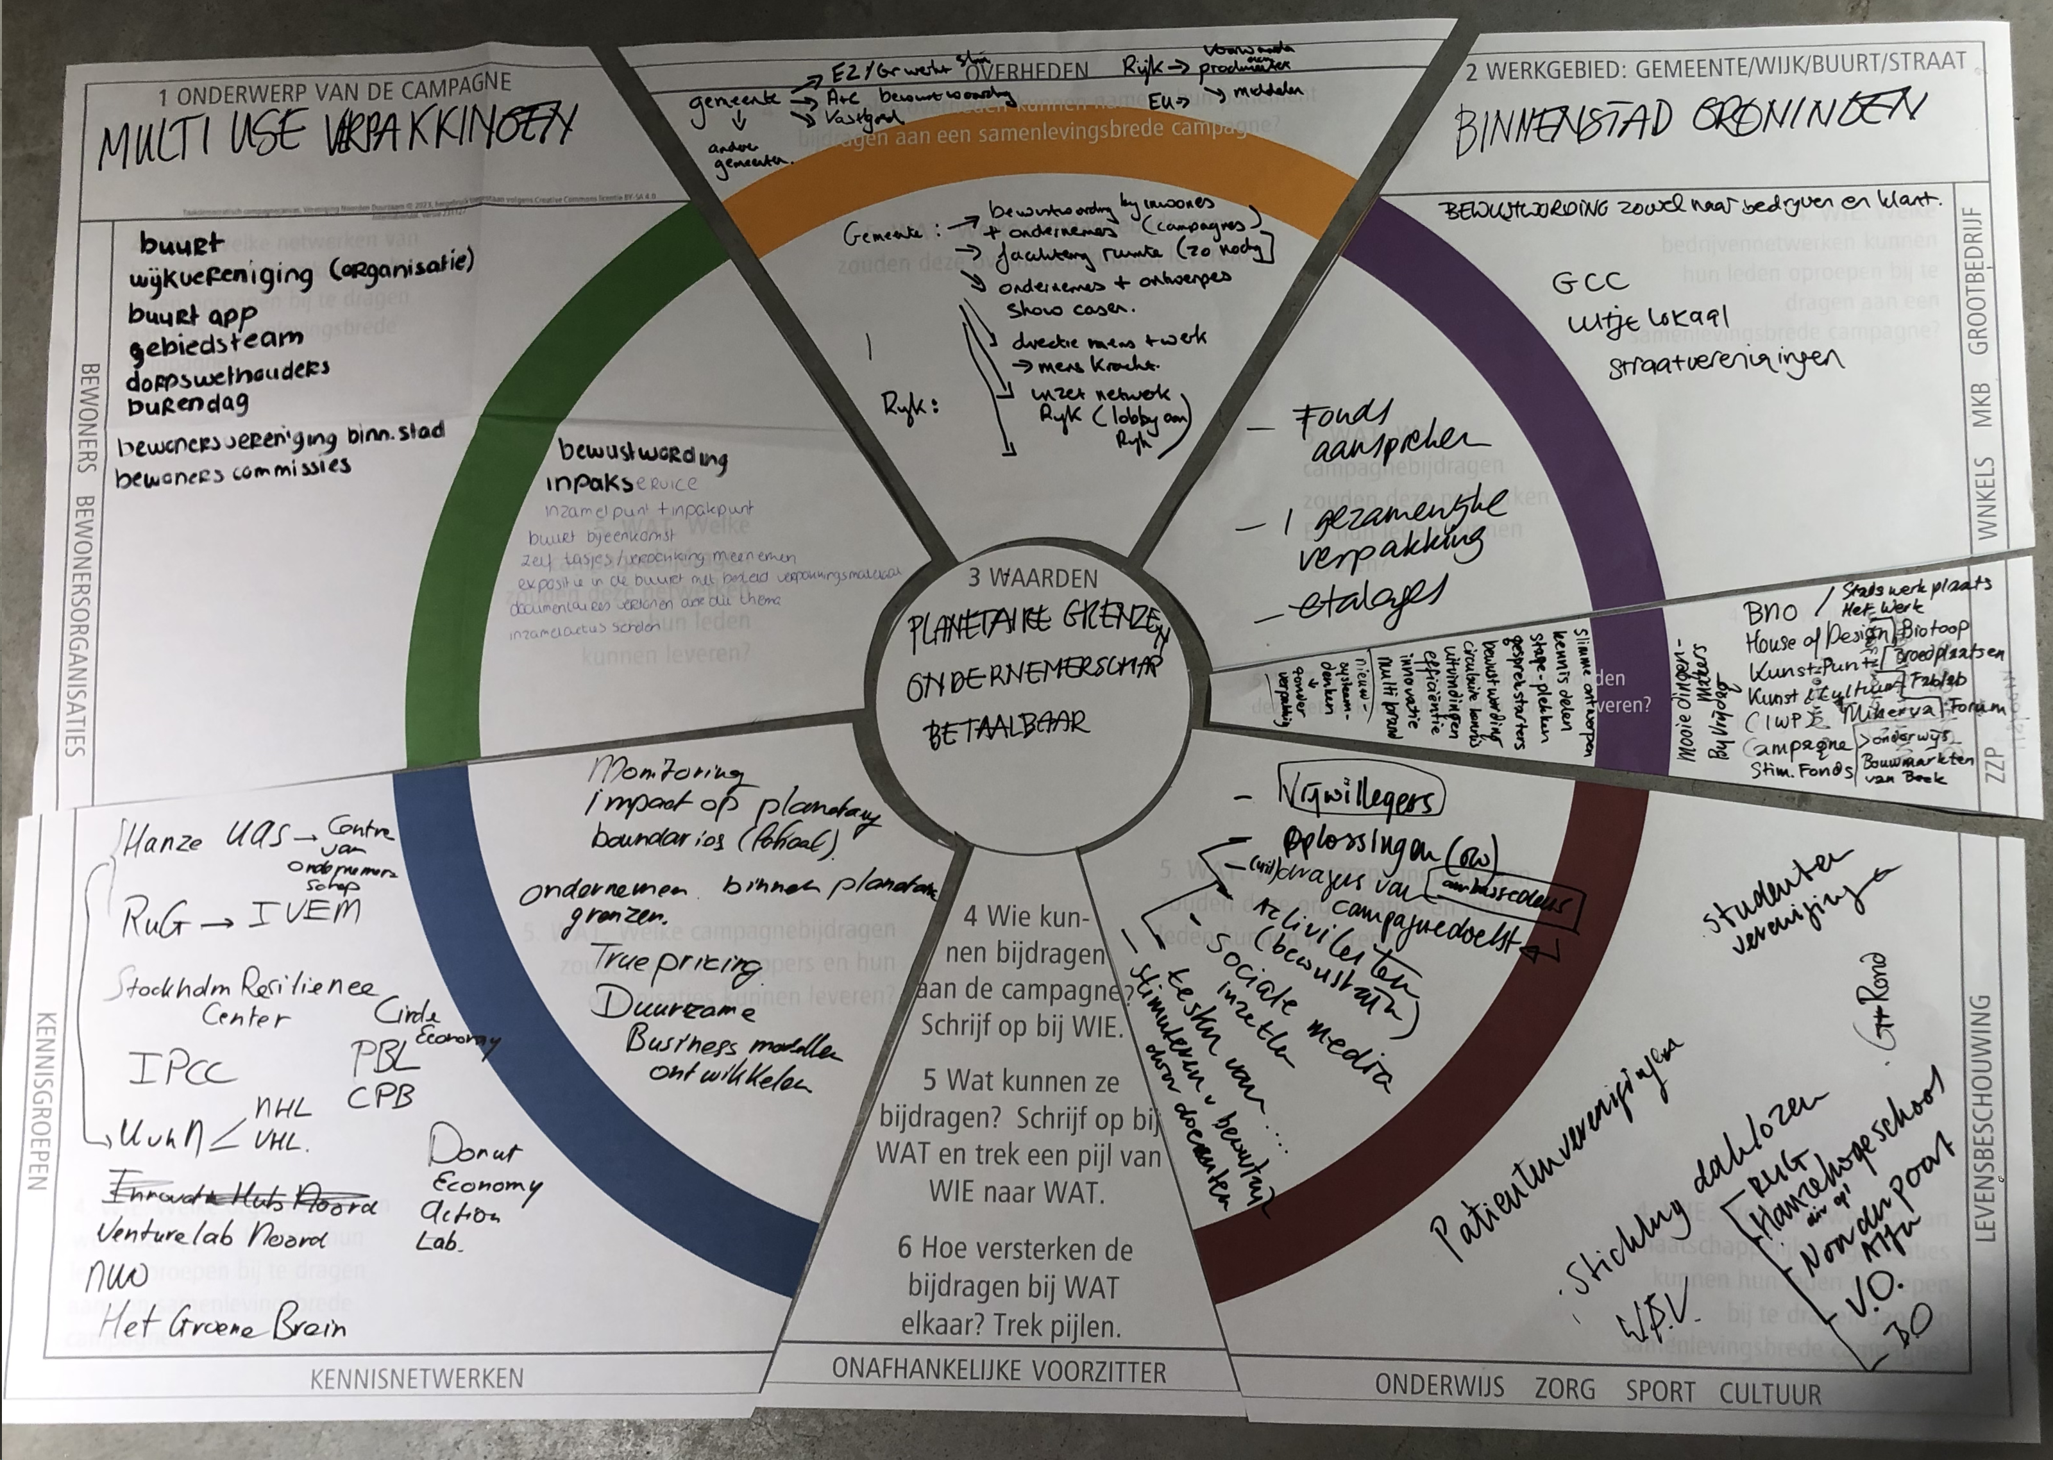
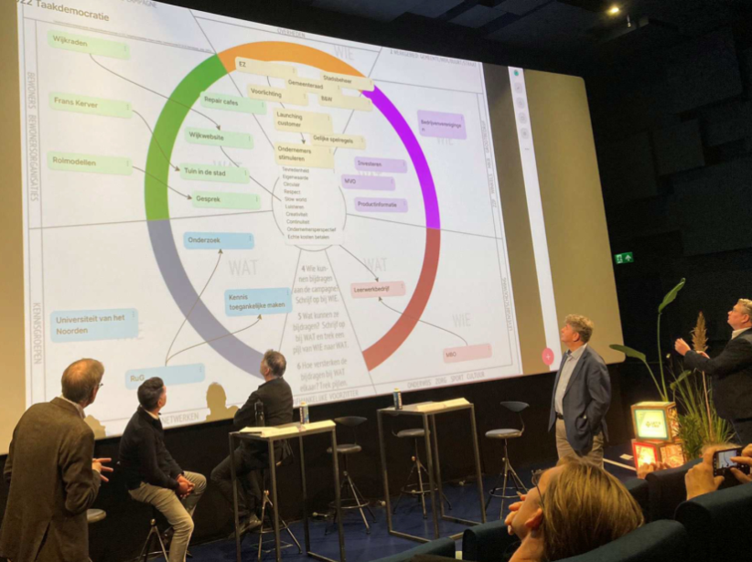
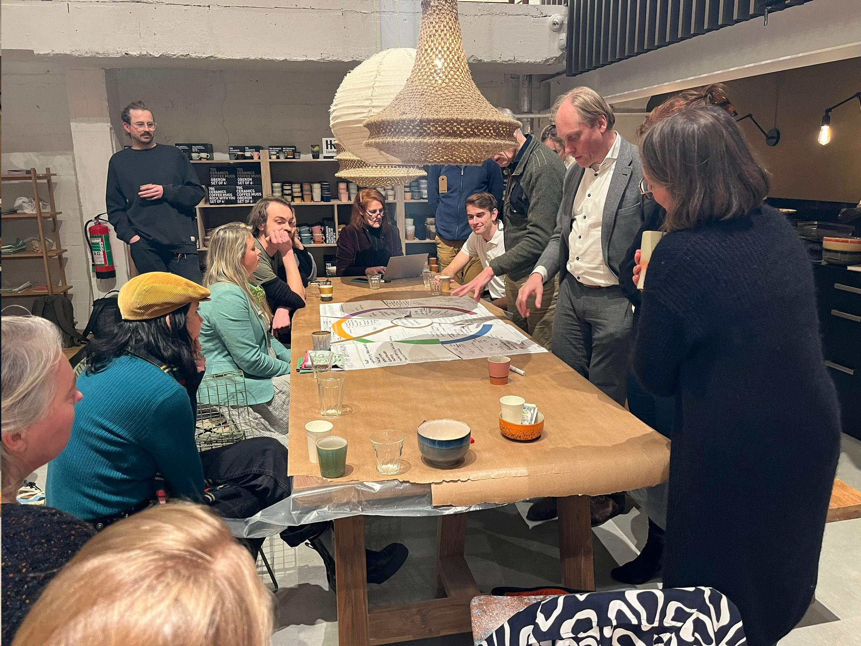
Brainstormcanvas

Slide 35

CAMPAGNE VOOR
OVERHEDEN
GEMEENTE WIJK BUURT STRAAT
Vinkmobiel
Gebiedsteam
Beleidsadviseurs
Vinkhuizen
Taakdemocratisch campagnecanvas, ontwerp Vereniging Noorden Duurzaam, 2021, hergebruik toegestaan volgens Creative Commons BY-SA 4.0 International
Budgetsteun
WelMobiel
Seniorenplatform
Risicodragende exploitatie
Mond tot mond reclame
Laadpaal
Opleiden en begeleiden
Passagiers
Spreekbuis voor doelgroepbelangen
Winkels
BEWONERS BEWONERSORGANISATIES
Aansluiting bij mobiliteitsbeleid
E-deelauto’s
ZZP WINKELS MKB GROOTBEDRIJF
WOV
Ritbijdragen
Centrale
Budgetsteun
Convenant
Sponsorbijdragen
Vrijwilligers
Chauffeurs
Mkb, zzp
Website / flyers
Sponsorbijdragen
RuG
Onderzoek formule en succesfactoren
Vergaderruimte
Penvoerderschap
Lentis
Hanzehoge-school
Proces-
begeleiding
Besturen
KENNISGROEPEN
LEVENSBESCHOUWING
Studenten-adviesbureaus
‘t Vinkhuys
Noorden Duurzaam
KENNISGROEPEN
ONAFHANKELIJKE VOORZITTER
ONDERWIJS ZORG SPORT CULTUUR

Slide 36
CAMPAGNE VOOR
OVERHEDEN
WIE
GEMEENTE WIJK/DORP BUURT STRAAT
Wijkuitvoeringsplan
Gemeente
Provincie
Rijk
Dorp
EU
Taakdemocratisch campagnecanvas, ontwerp Vereniging Noorden Duurzaam, 2021, hergebruik toegestaan volgens Creative Commons BY-SA 4.0 International
Warmtevisie
Bouw, Installatie
Horeca, Recreatie
Kantoren
Winkeliers
Agrarisch
Ander MKB
ZZP
Grootbedrijf
Eigenaar-bewoners van woningen
EFRO
subsidie
Revitalisering
1 Wie kunnen bijdragen
aan de campagne?
Schrijf op bij WIE.
2 Wat kunnen ze bijdragen? Schrijf op bij WAT en
trek een pijl van WIE naar WAT.
3 Hoe versterken de bijdragen bij WAT elkaar? Trek pijlen.
Huurders
van
woningen
Energiebesparen
WAT
WIE
WIE
Innoveren
Woningbouw
Investeren
ZZP WINKELS MKB GROOTBEDRIJF
Investeren
BEWONERS BEWONERSORGANISATIES
WAT
WAT
Collectief vormen
Energiebesparen
Energietransitie
Gastlessen
Consulteren
Lesthema’s
Kerk
HBO, WO
Voorlichting
WAT
WAT
Schoolbestuur
Adviseren
Investeren
WUP opstellen
Zorginstelling
Werkgroep voor Energietransitie
Stages
Sportvereniging
WIE
KENNISGROEPEN
Afstemmen
Woningcorporatie
LEVENSBESCHOUWING
WIE
Kennisinstituut
Maatschappelijk vastgoed
Vereniging
Dorpsbelangen
Onafhankelijke experts
Culturele organisatie
KENNISGROEPEN
ONAFHANKELIJKE VOORZITTER
ONDERWIJS ZORG SPORT CULTUUR

